Slide 1

The Olympic Games: A Global Celebration of Sport
The Olympic Games, a global sporting spectacle, bring together athletes from every corner of the world to compete for ultimate glory. Every four years, the world watches as these individuals push the boundaries of human potential, fostering international unity and inspiring future generations.

Slide 2
Ancient Origins: From Olympia to the Modern Era
The Olympic Games originated in ancient Greece, held in Olympia in honor of Zeus, the king of the gods. These games were a religious and cultural festival, celebrating athletic excellence, and promoting unity among the Greek city-states.
After centuries of decline, the modern Olympic Games were revived in 1896, thanks to the efforts of French baron Pierre de Coubertin, who envisioned a world where sports would bridge cultural and political divides.

Slide 3
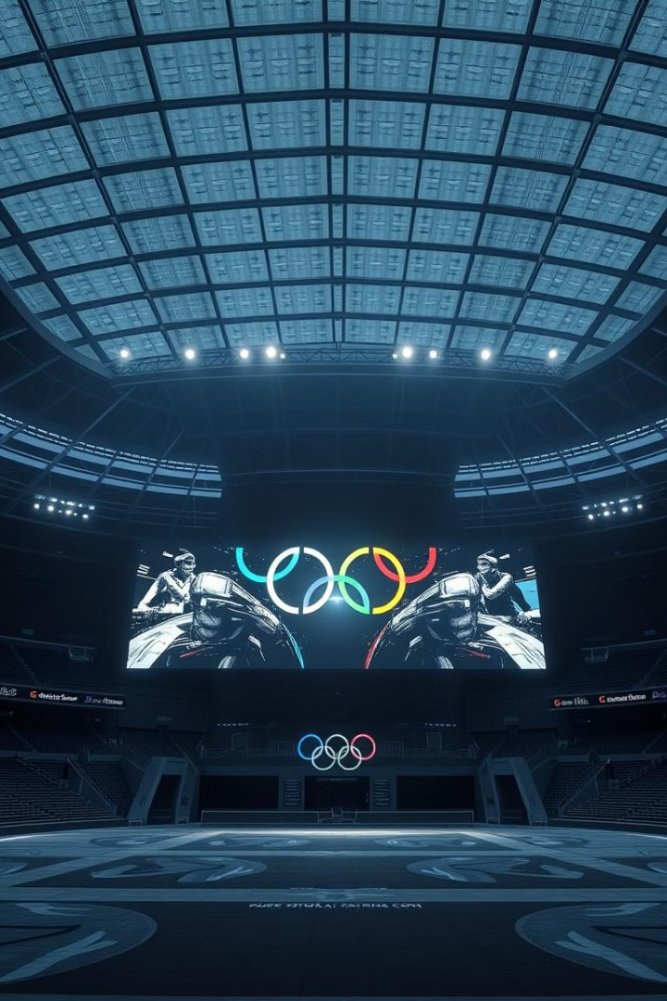
The Olympic Rings: Symbolism and Significance
1
The five interlocking rings represent the five continents of the world: Africa, Asia, America, Europe, and Oceania. Each ring has a distinct color, representing one of the colors found in the flags of all participating nations.
2
This powerful symbol of unity embodies the spirit of the Olympics, where athletes from different countries compete on a level playing field, fostering mutual respect and understanding.

Slide 4
Summer vs. Winter Olympics: A Tale of Two Seasons
The Summer Olympics, held every four years, feature a wide range of sports, including athletics, swimming, gymnastics, and team sports like football and basketball. The Summer Olympics are a celebration of speed, strength, and agility.
The Winter Olympics, also held every four years, focus on winter sports such as skiing, snowboarding, ice hockey, and figure skating. The Winter Olympics showcase athletes' skills and grace in the challenging conditions of winter.

Slide 5
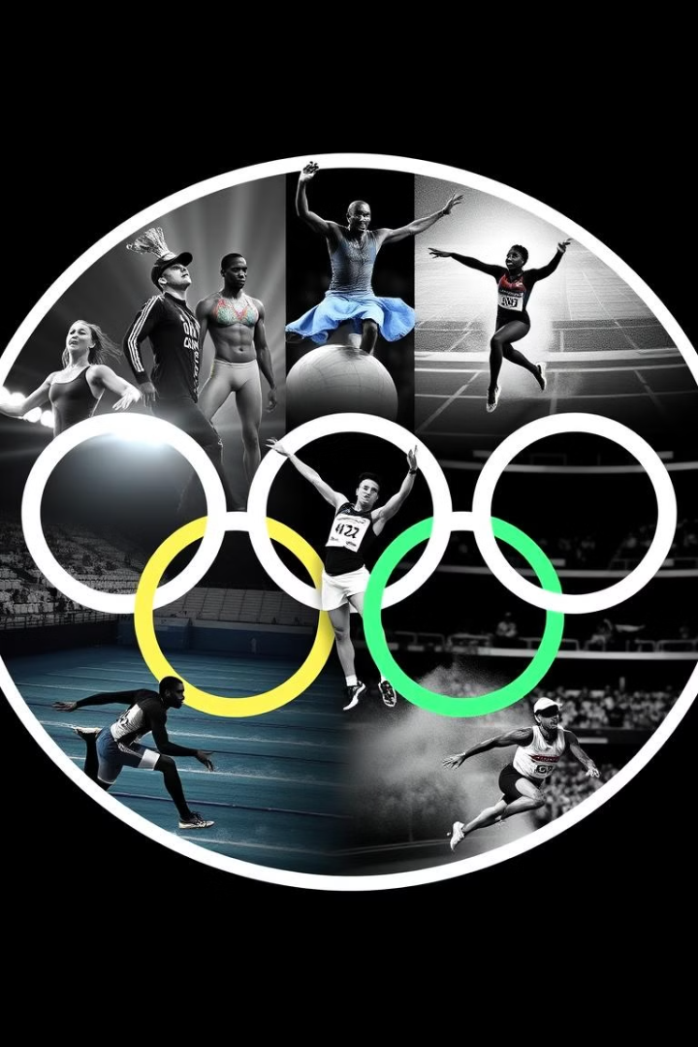
Iconic Moments: Defining Performances in Olympic History
1
Jesse Owens's four gold medals at the 1936 Berlin Olympics challenged racial prejudice and demonstrated the power of sports to transcend political barriers.
2
Nadia Comaneci's perfect 10 score in gymnastics at the 1976 Montreal Olympics captivated the world, showcasing the peak of human artistry and athleticism.
3
Michael Phelps's record-breaking swims at multiple Olympics cemented his status as one of the greatest swimmers of all time, pushing the limits of human endurance.
4
Usain Bolt's record-breaking sprints at the Beijing Olympics in 2008 captivated the world, displaying incredible speed and athleticism.

Slide 6
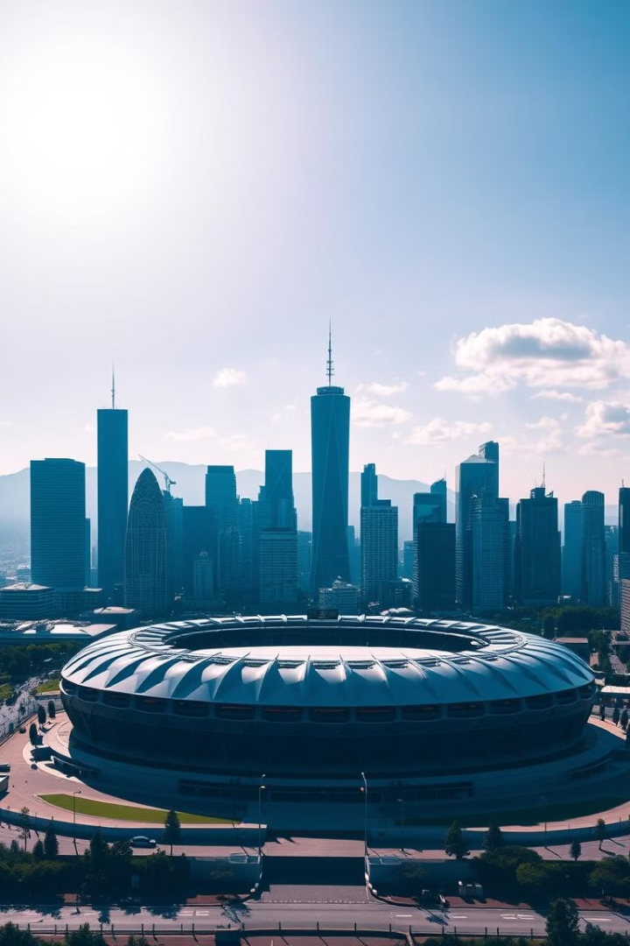



The Host City Selection Process: Bidding and Preparation
Host city selection starts with a bidding process, where cities compete to host the Games. Cities submit detailed bids outlining their infrastructure, accommodation, and security plans.
The International Olympic Committee (IOC) evaluates bids based on various factors, including the city's infrastructure, its ability to accommodate athletes and spectators, and its commitment to sustainability.
The host city undertakes extensive preparations, including construction of venues, training facilities, and accommodation for athletes and officials, ensuring a successful and memorable event.

Slide 7
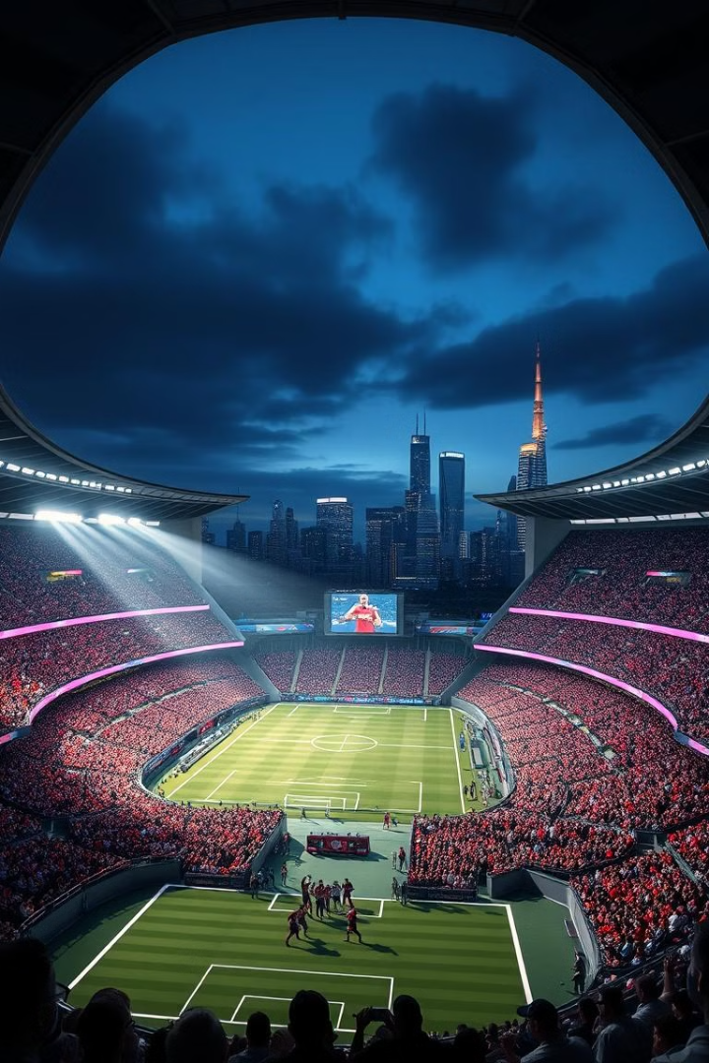
Economic Impact: Benefits and Challenges for Host Cities
2
$1B
Economic Boost
Infrastructure Investment
The Olympics create a significant economic boost for host cities, generating revenue from tourism, hospitality, and media rights.
Hosting the Games often leads to significant infrastructure investment, including new transportation systems, sports facilities, and public spaces.
2.5
Job Creation
The Games create numerous jobs in construction, hospitality, and event management, providing opportunities for local residents.

Slide 8
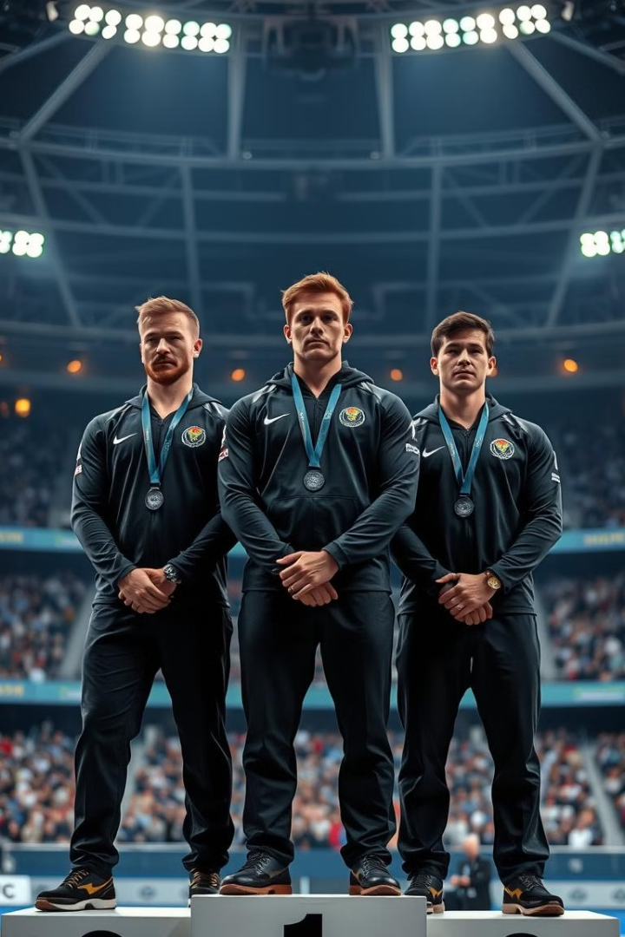



Controversies and Challenges: Doping, Politics, and Security
Doping scandals hurt the Olympic spirit and cause arguments about fairness in sports.
Sometimes, political problems and boycotts have interrupted the Games, making it hard to keep the idea of world unity.
Terrorism and security concerns make it difficult for host cities to protect athletes and fans, requiring strong safety plans.

Slide 9



The Future of the Olympics: Innovation and Sustainability
Technology
1
The IOC is exploring innovative technologies to enhance the athlete experience, engage fans, and promote accessibility.
Sustainability
2
The Olympics are increasingly emphasizing sustainability, promoting responsible environmental practices and minimizing the Games' carbon footprint.
Accessibility
3
The IOC is working to make the Games more accessible to all, including people with disabilities and those from marginalized communities.

Slide 10
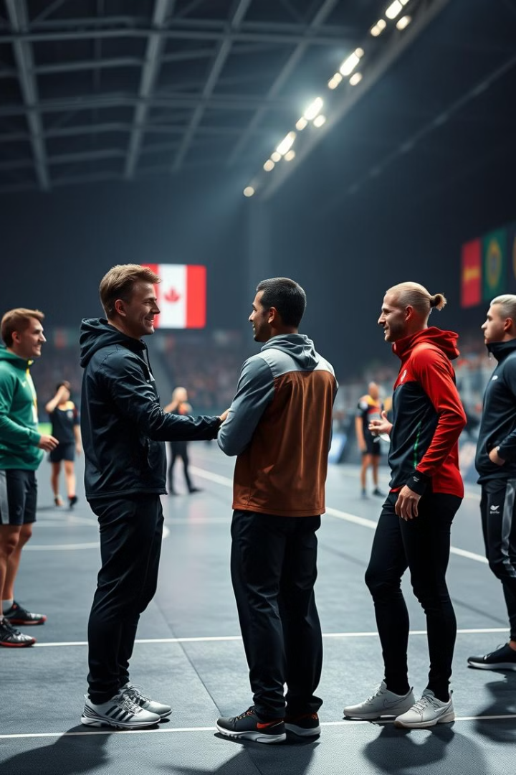
Key Takeaways: Celebrating the Olympic Spirit
The Olympic Games, a testament to human potential and international collaboration, continue to inspire generations with their message of sportsmanship, determination, and global unity. As the world evolves, the Games will undoubtedly adapt and innovate, ensuring that the Olympic spirit continues to shine brightly for years to come.

